Slide 1
Introduction
Thanks for downloading the single slide overviews of SFTool topics! Drop any of these slides into your presentation to brief specific components of SFTool. The slides highlight major topics on SFTool, but you can just use the ones you need.
The slides are animated to progressively introduce the resources available on SFTool. A corresponding script is provided in the notes section of each slide. The script can be used as is, or as a starting point for your briefing.
Don’t hesitate to reach out with any questions!
Thanks,
The SFTool Team
sftool@gsa.gov
Please delete this slide before presenting.

Slide 2


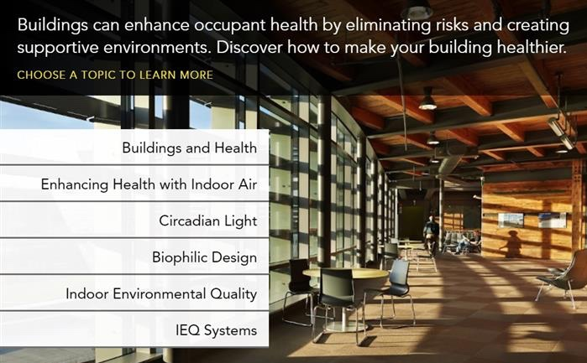
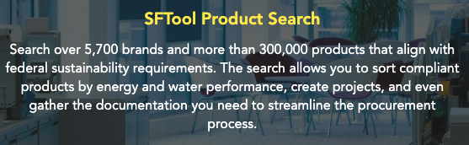
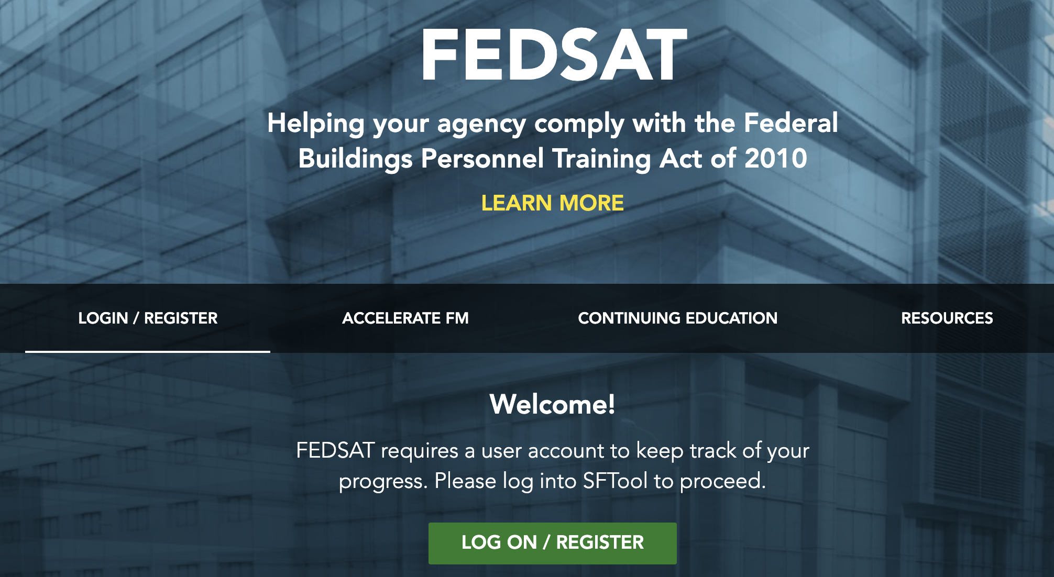
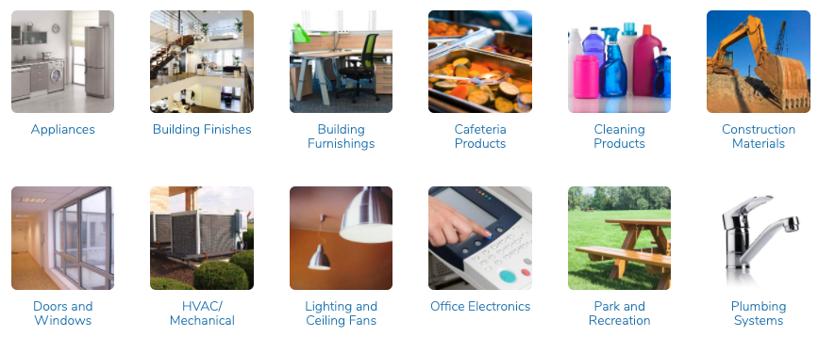
Overview of SFTool Topics
Notes:
The Sustainable Facilities Tool (SFTool) serves as a one stop website to meet all high-performance planning, designing, and procurement needs. Its purpose is to simplify, for both government and private-sector property managers, high-performance building practices and compare options for renovation projects. SFTool offers an easy to use learning platform highlighting best practices, case studies, and relevant regulations with an additional capability to compare building materials and systems across an array of high-performance criteria within an interactive virtual office environment.

Slide 3

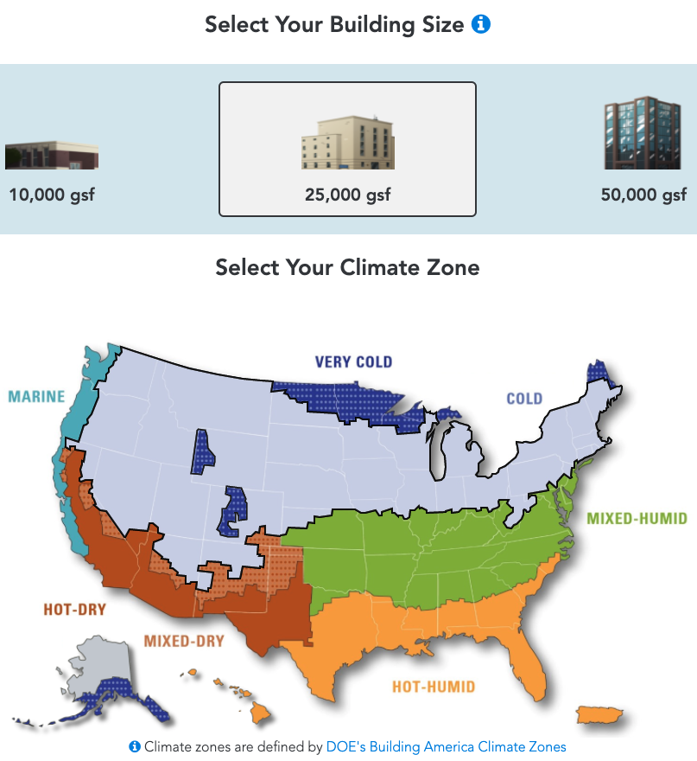
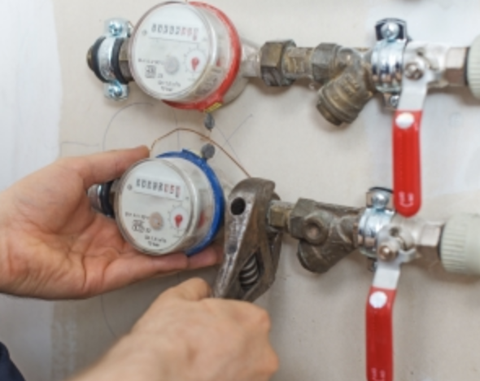
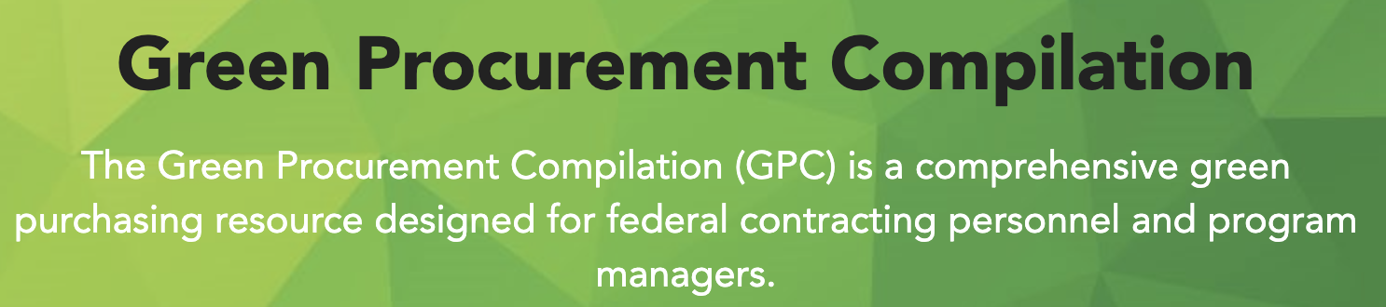




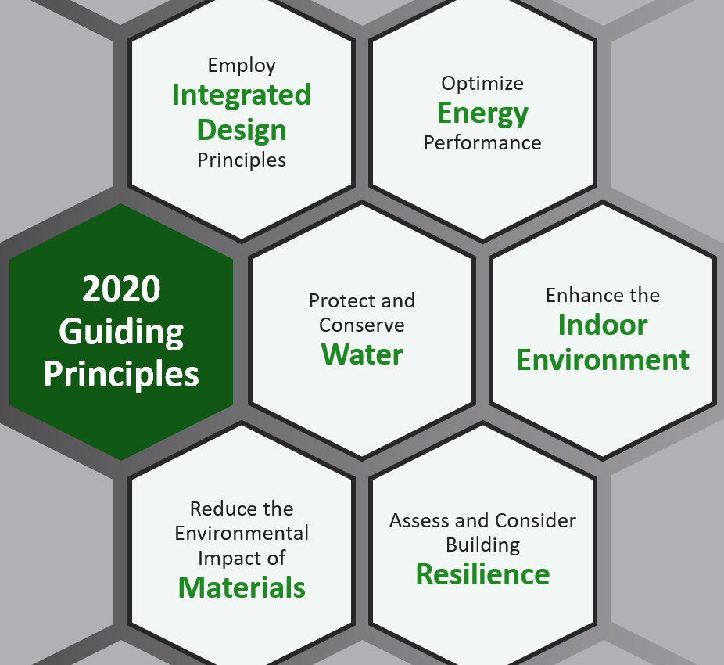
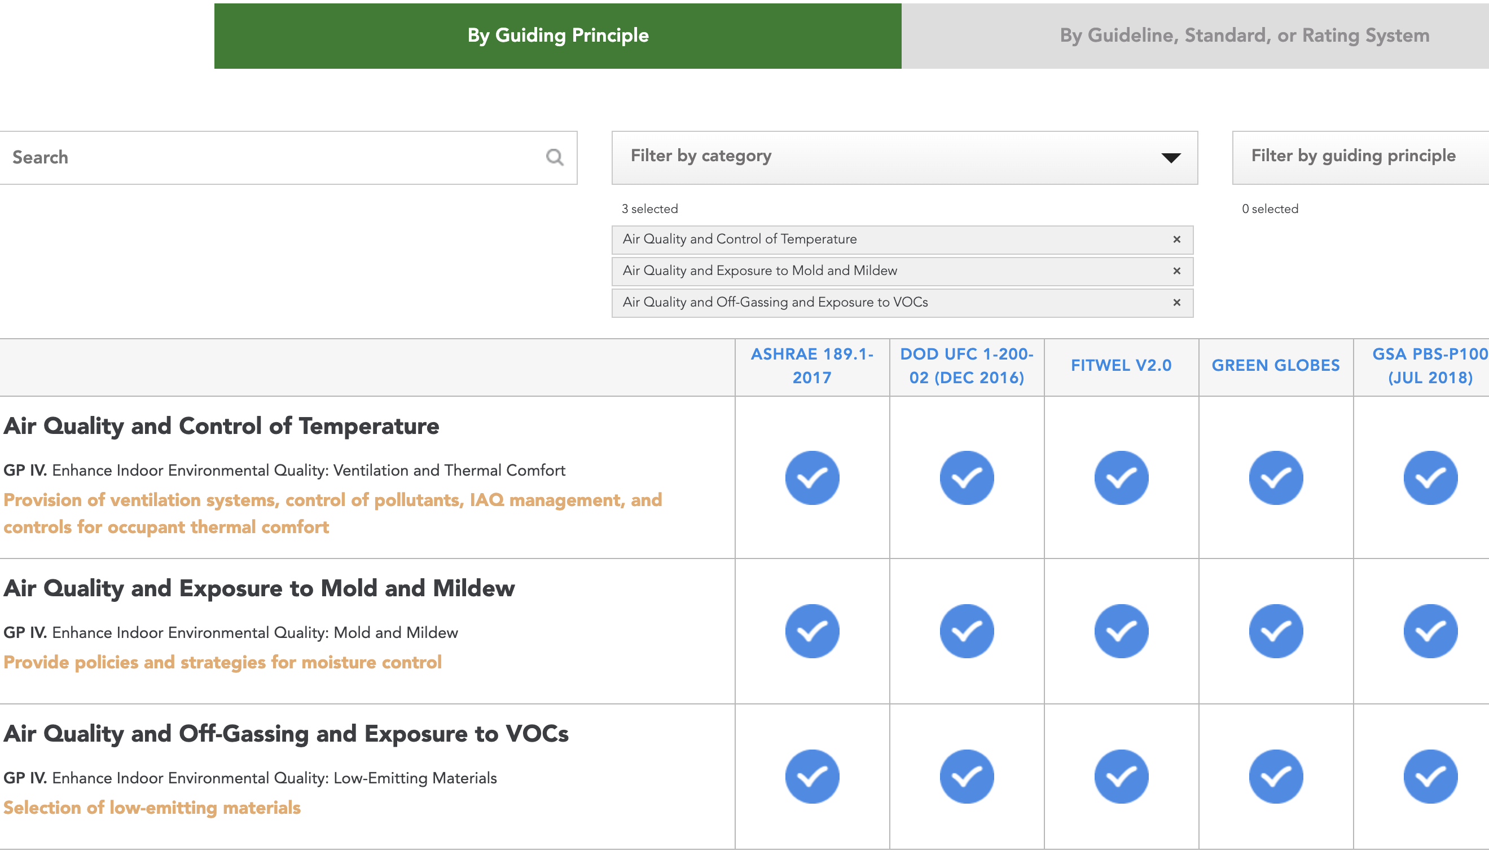
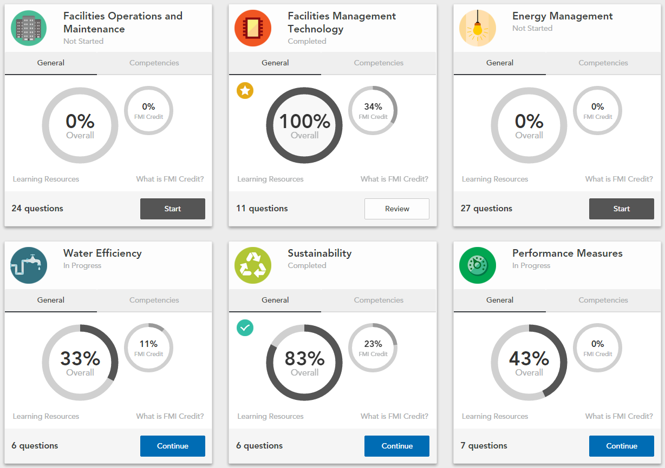
Helpful Tools
sftool.gov/home/about
Acquisition Planning and Requirements Development
Cost Effective Upgrades Tool
Submetering Wizard
Sustainable acquisition across the procurement lifecycle
Contract Award
Contract Administration
Contract Closeout
Health & Wellness Guidance Crosswalk
FEDSAT Training
Notes:
ANIMATED SLIDE IN FOUR SEQUENCES – BY CLICK
STARTING ON THE SLIDE
Tools to help with everyday tasks built into the webpage.
https://sftool.gov/home/about
The tools can be broken out into four categories: Project Planning and Development, Procurement, O&M, and Understanding Federal Requirements,
SEQUENCE 1:
Cost Effective Upgrades: Learn what energy conservation measures could be most cost-effective based on the size and location of your building.
https://sftool.gov/plan/upgrades
SEQUENCE 2:
The Submetering Wizard provides information about the comprehensive uses and benefits of submetering systems.
https://sftool.gov/plan/submetering
SEQUENCE 3:
Explore Federal government tools and resources for cost-effective and sustainable acquisition across the procurement lifecycle.
https://sftool.gov/plan/419/acquisition-life-cycle-tools
SEQUENCE 4:
Identify federal green purchasing requirements for products and services using the Green Procurement Compilation.
https://sftool.gov/greenprocurement
SEQUENCE 5:
In the SFTool Facilities Management Institute, assess facility operations knowledge and identify areas for training using the FEDSAT training, and locate additional free resources.
https://sftool.gov/fedsat
SEQUENCE 6:
Explore how the Guiding Principles relate to health and wellness guidelines, standards, and building rating systems using the Health & Wellness Guidance Crosswalk.
https://sftool.gov/learn/crosswalk
SEQUENCE 7:
Click through Annotated Executive Orders and Guiding Principles with strategies, definitions, and resources to ensure projects comply with Federal mandates.
https://sftool.gov/learn/2/federal-requirements
https://sftool.gov/learn/about/631/guiding-principles-sustainable-federal-buildings

Slide 4
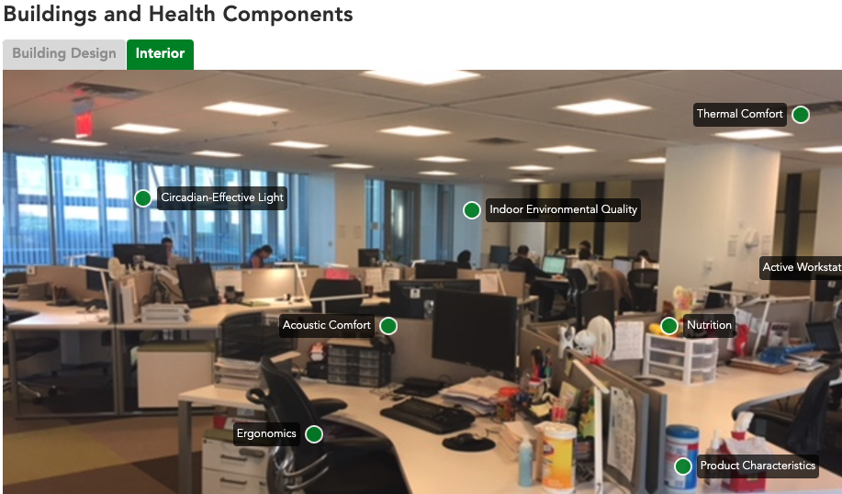
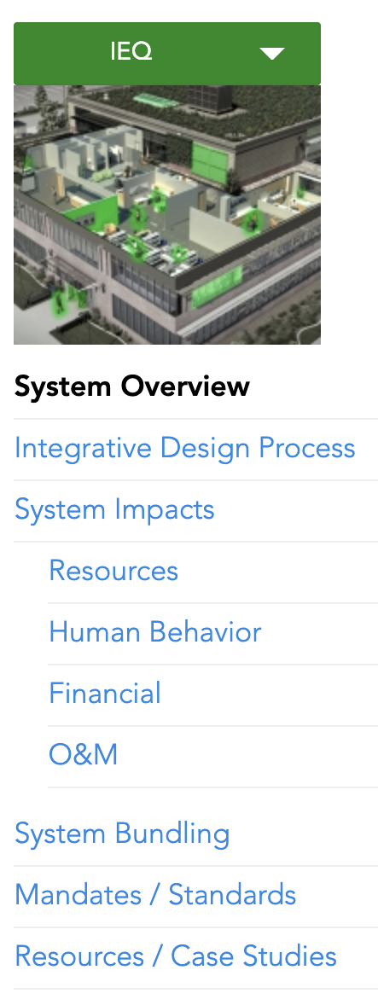
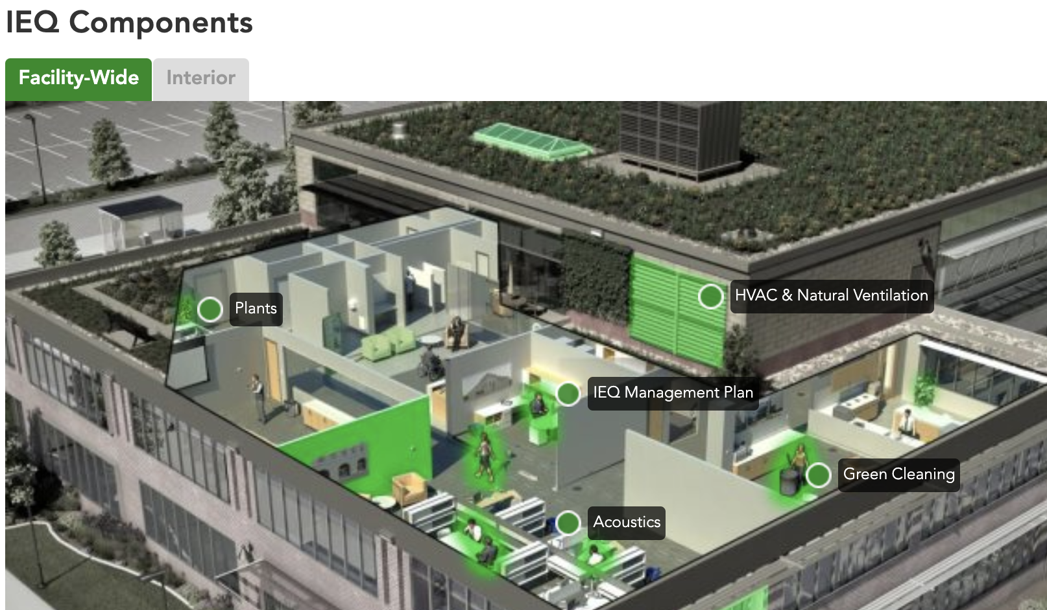
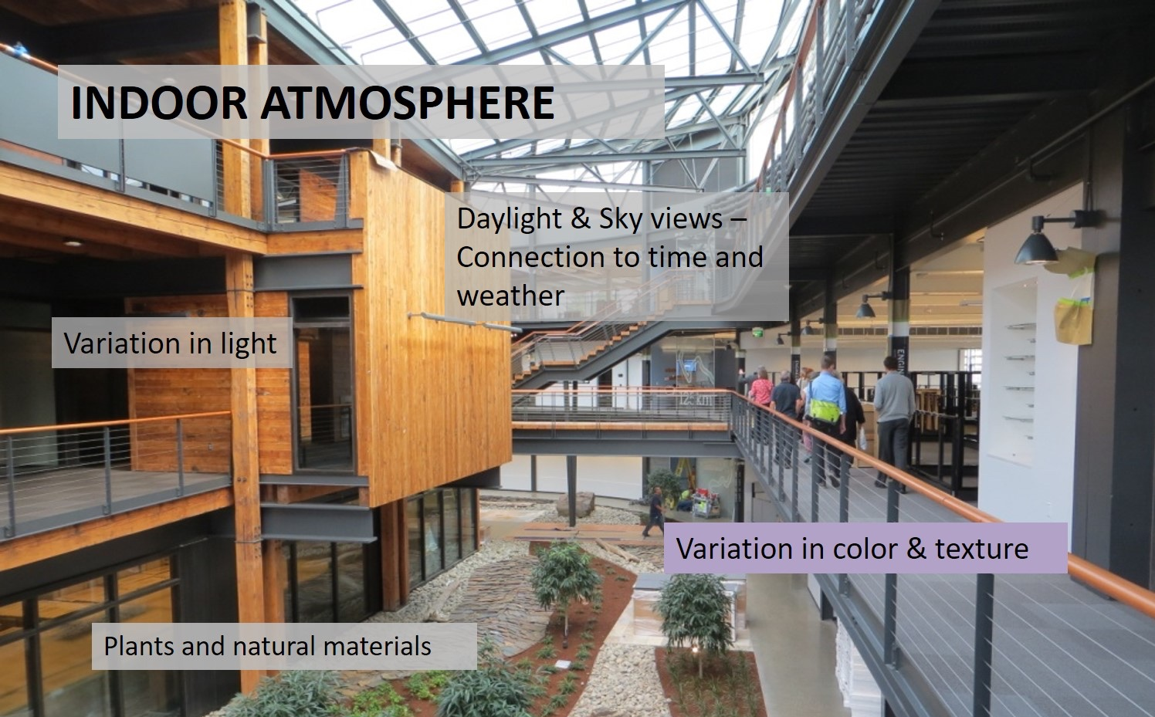
Health
sftool.gov/learn#learn-health
Explore components of Buildings and Health
Includes the Health and Wellness Guidance Crosswalk
Improve IEQ Systems and Indoor Environmental Quality
Learn about Enhancing Health with Indoor Air
Discover how Circadian Light and Biophilic Design affect occupants
Notes:
ANIMATED SLIDE IN FOUR SEQUENCES – BY CLICK
STARTING ON THE SLIDE
SFTool provides resources for optimizing the built environment for occupant health.
https://sftool.gov/learn#learn-health
SEQUENCE 1
The Buildings and Health module includes a comprehensive suite of building system components guides.
https://sftool.gov/learn/about/576/buildings-health
SEQUENCE 2
On the Buildings and Health page there is a related Health and Wellness Guidance Crosswalk to connect the dots between the Guiding Principles for Sustainable Federal Buildings and other industry standards, guidelines and rating systems. The crosswalk is updated for LEED v4.1 and WELL v2 in May 2019.
https://sftool.gov/learn/crosswalk
SEQUENCE 3
Enhancing Health with Indoor Air covers four key levers that inform how to improve the indoor environment. Each lever includes specific actions and measurable environmental outcomes.
https://sftool.gov/learn/about/626/enhancing-health-indoor-air
Circadian Light and Biophilic Design are two resources to learn how occupants react to working within a built environment. These pages explore topics such as daylighting, exposure to nature, and vegetation, and how these factors affect mood, performance, engagement, and sleep cycles.
https://sftool.gov/learn/about/577/circadian-light
https://sftool.gov/learn/about/580/biophilic-design
SEQUENCE 4
Explore Indoor Environmental Quality (IEQ) and IEQ Systems thorough the interactive virtual facility tour on how to improve IEQ
https://sftool.gov/learn/about/1/indoor-environmental-quality-ieq
https://sftool.gov/explore/green-building/section/30/ieq/system-overview

Slide 5
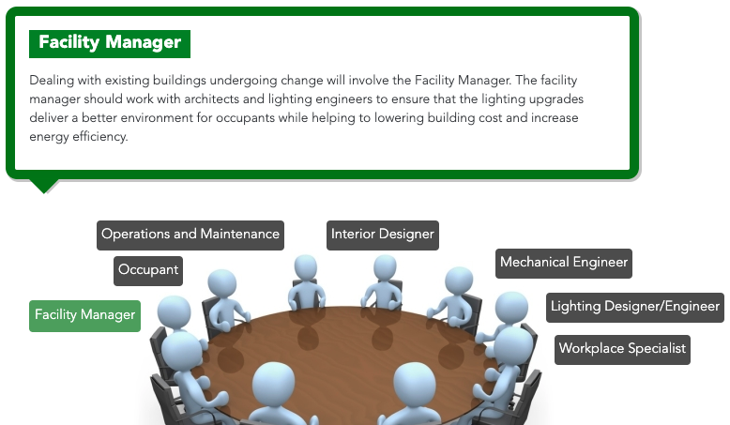
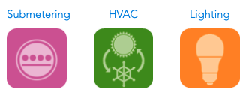
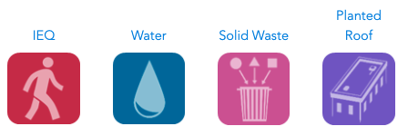
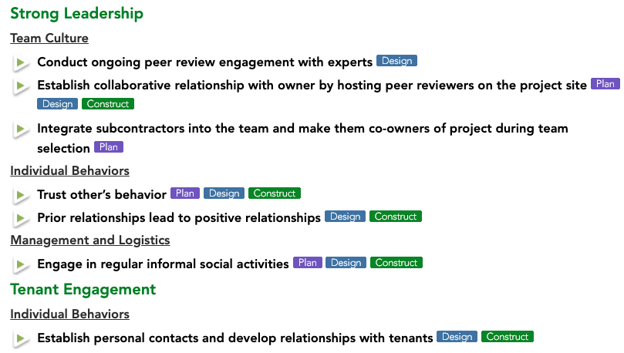
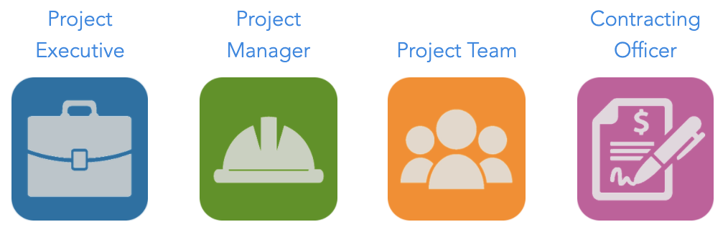
Integrative Design
sftool.gov/plan/261/integrative-design-process
By Topic:
Work through the Integrative Design Process to deliver high-performance buildings on time and on budget
Discover synergies among project stakeholders
Understand stakeholder responsibilities
By Role:
Explore roles for coordinating a successful project
Learn best collaboration practices
Notes:
ANIMATED SLIDE IN TWO SEQUENCES – BY CLICK
STARTING ON THE SLIDE
In federal building projects, collaborative, integrative processes are required under the Guiding Principles for Sustainable Federal Buildings.
The Integrative Design Process pages on SFTool looks for synergies among strategies – strategies that enhance one another or together reduce costs.
https://sftool.gov/plan/261/integrative-design-process
SEQUENCE 1:
BY TOPIC:
Seven whole building system project categories are provided to give specific team strategies for each.
SEQUENCE 2:
After choosing a whole building system category curated collaboration methods are provided for successful roundtable discussion and project execution.
E.g., lighting: https://sftool.gov/explore/green-building/section/2/lighting/integrative-design-process
A set of stakeholders that should be engaged are listed, and their responsibility in the project is explained.
SEQUENCE 3:
BY ROLE:
Collaborative Strategies for Project Teams looks beyond design methods to explain how to apply the integrative design methods through the different leadership roles.
https://sftool.gov/plan/583/collaborative-strategies-project-teams
SEQUENCE 4:
Each of the four project roles contains three main categories: Strong Leadership, Tenant Engagement, and Commercial Strategies.
E.g., project team: https://sftool.gov/plan/586/project-team
The three main categories previously listed are further broken down as appropriate to give further insight into Team Culture, Individual Behaviors, Management and Logistics, and Communication.
Each collaborative strategy is tagged with the step or steps in the process in which the strategy should be applied. These steps cover the life cycle of a project and are Project Planning, Design, Construction, and Post Occupancy.

Slide 6
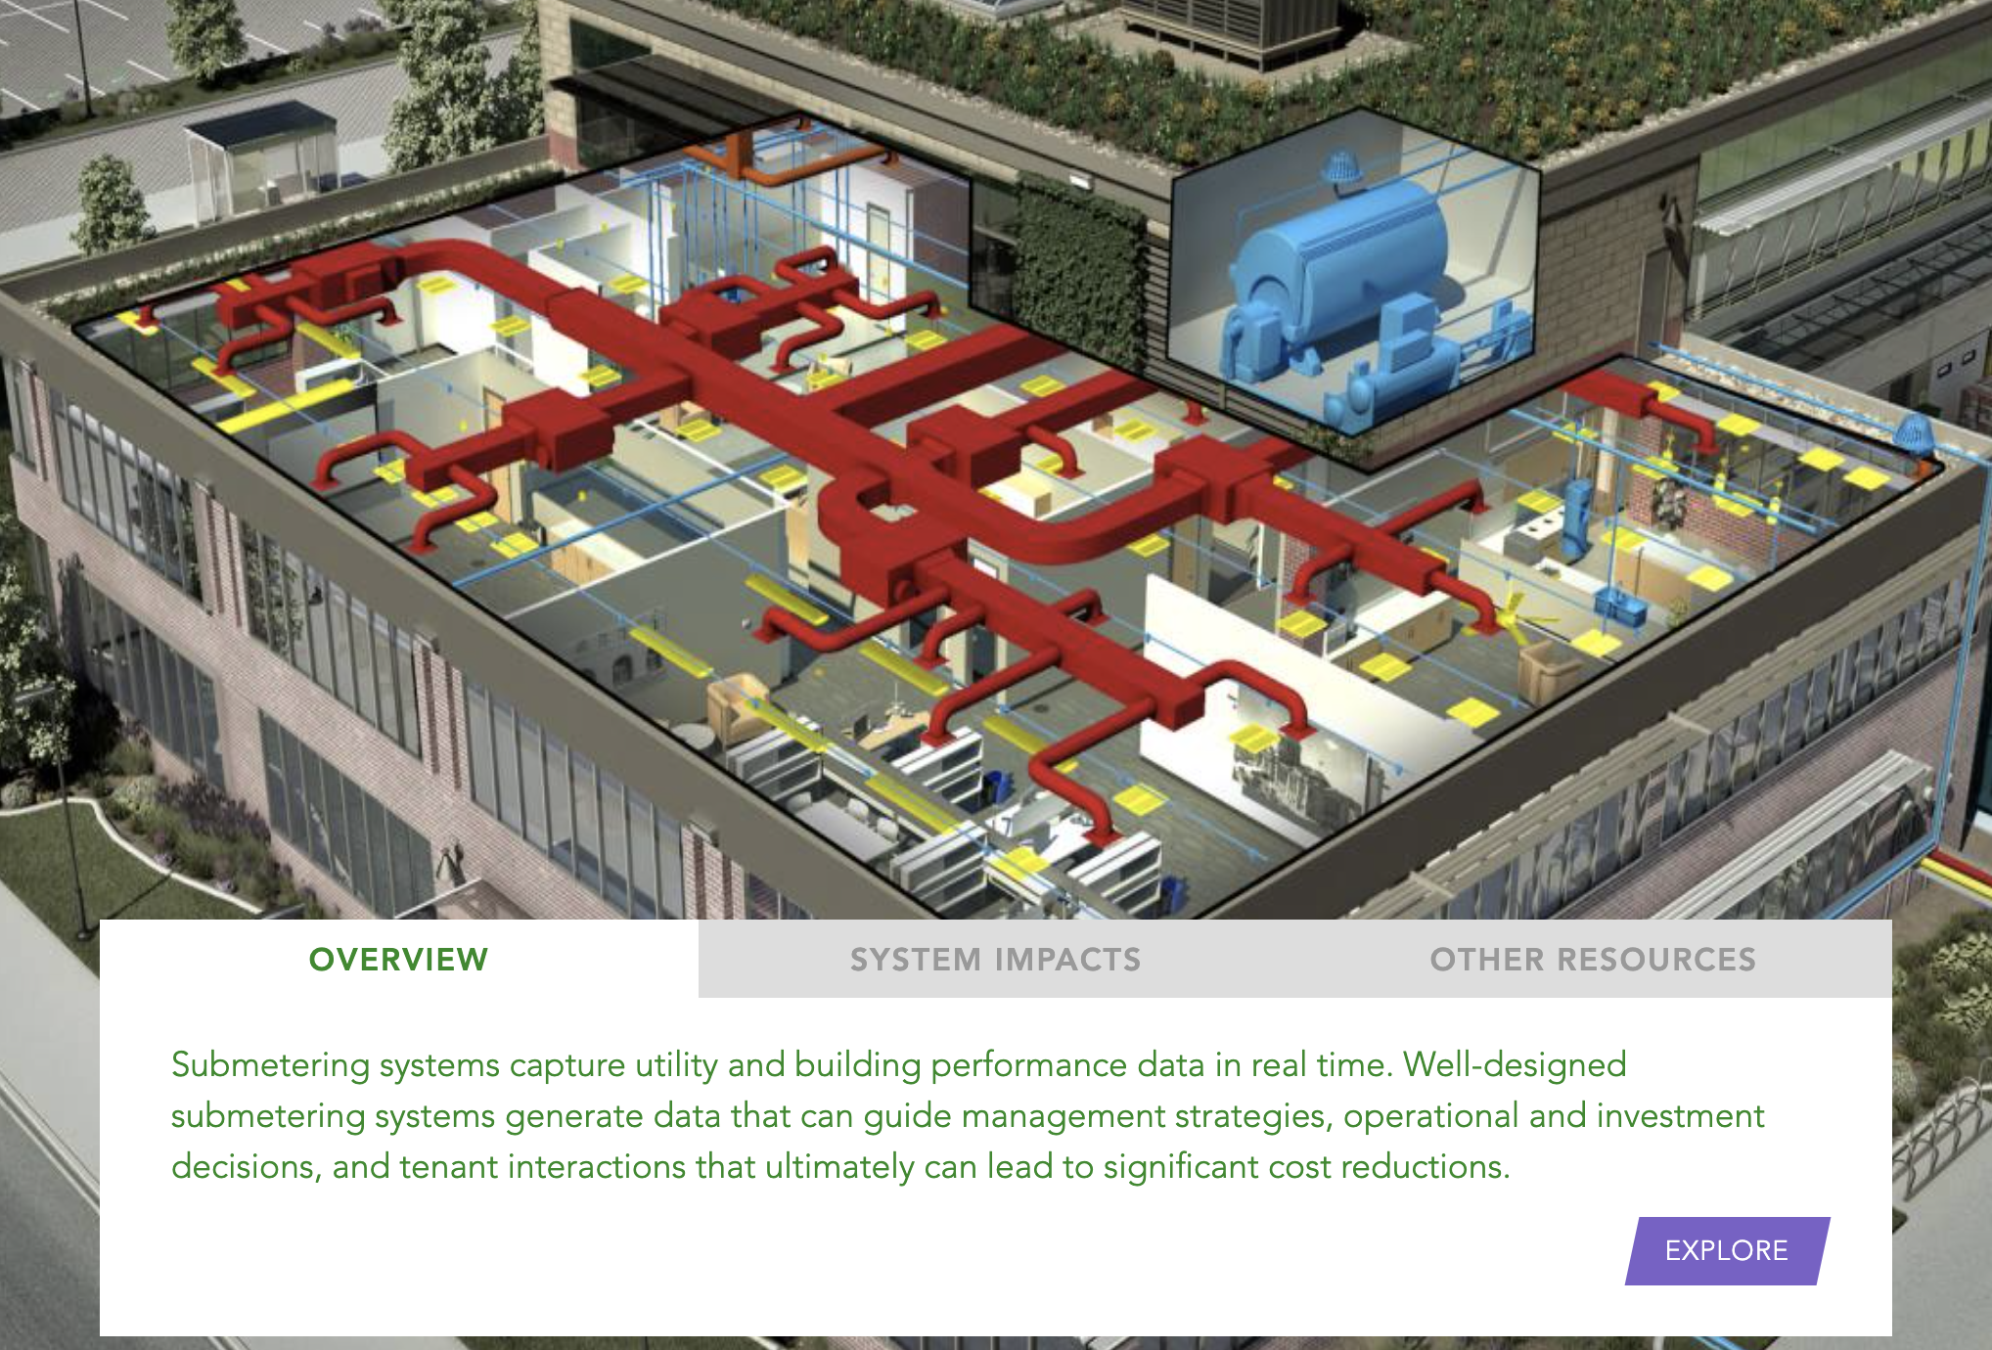
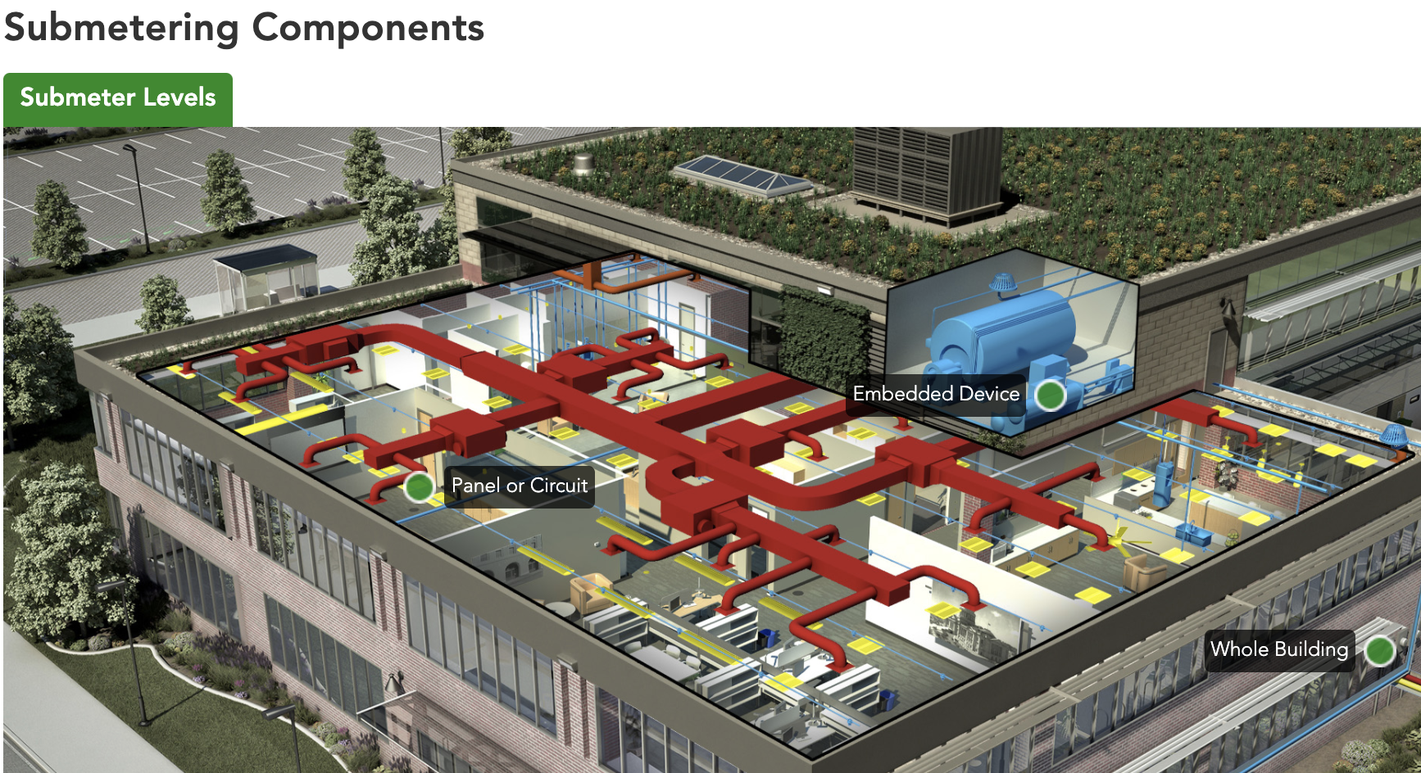
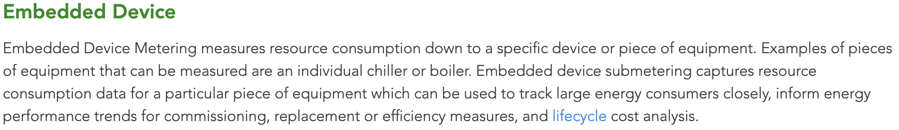
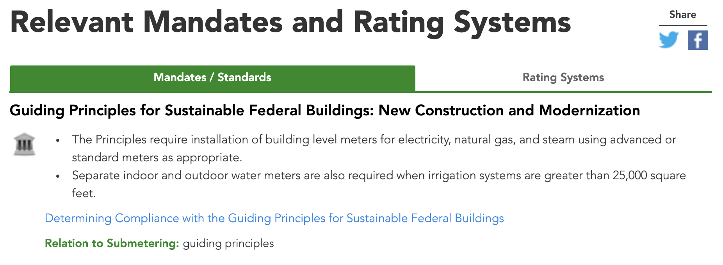
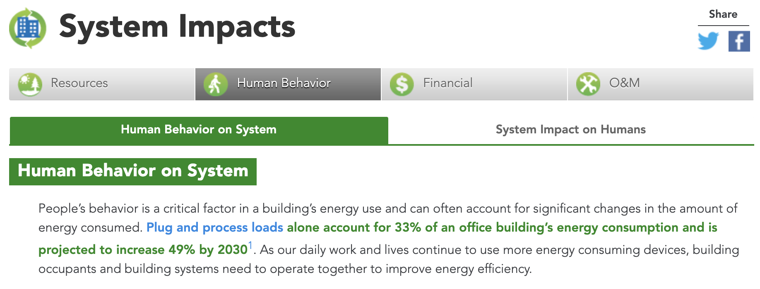
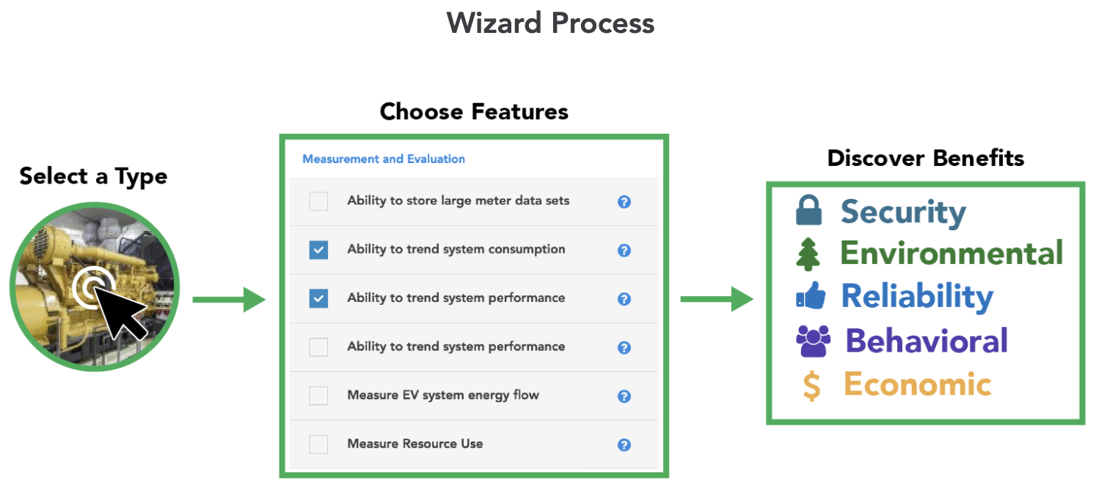
Building Systems
sftool.gov/explore#building-systems
Explore building systems and their unique components
Understand Mandates / Standards based on federal requirements
Use the SFTool Wizard to go in depth on techniques and benefits
Notes:
ANIMATED SLIDE IN FOUR SEQUENCES – BY CLICK
STARTING ON THE SLIDE
Explore Building Systems, their relationship to one another, and the integrative team necessary to reach sustainability goals.
https://sftool.gov/explore#building-systems
SFTool breaks down seven whole building systems: Lighting, HVAC, Water, Indoor Environmental Quality, Solid Waste, Planted Roof, and Submetering.
SEQUENCE 1:
Each Whole Building System has a set of components to explore. The components of each system are defined through Green Dots that explain their function in the system.
SEQUENCE 2:
System Impacts takes a holistic approach to explain how a Building System is affected by its environment, and how it affects the environment it is placed in.
Resources Impact – the sustainability value of informed system planning and installation. See also: System Bundling to further optimize project planning and execution.
Human Behavior – both how the system is effected by the building occupants, and how the system effects building occupants.
Financial Impact - breaking down the economic feasibility of a building system installation, and its life cycle cost.
Operations and Maintenance – optimize O&M strategies for building equipment and technologies.
SEQUENCE 3:
Relevant Federal Mandates and Standards are listed for each Building System, including Guiding Principles, Executive Orders, and Presidential Memorandums.
Rating systems that are applicable to a building system are listed, such as LEED and Green Globes.
SEQUENCE 4:
SFTool has built in tools such as the Submetering Wizard or Cost Effective Upgrades to help identify the system type that works best based on the requirements for specific buildings.
https://sftool.gov/plan/submetering
https://sftool.gov/plan/upgrades

Slide 7
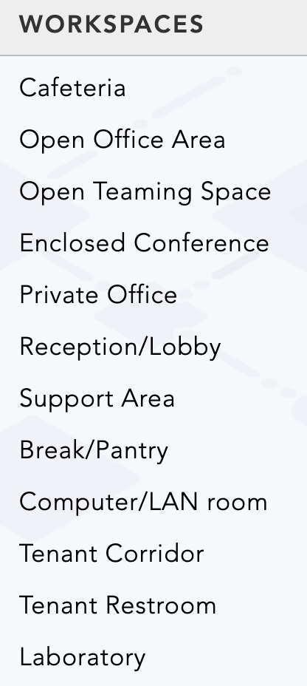
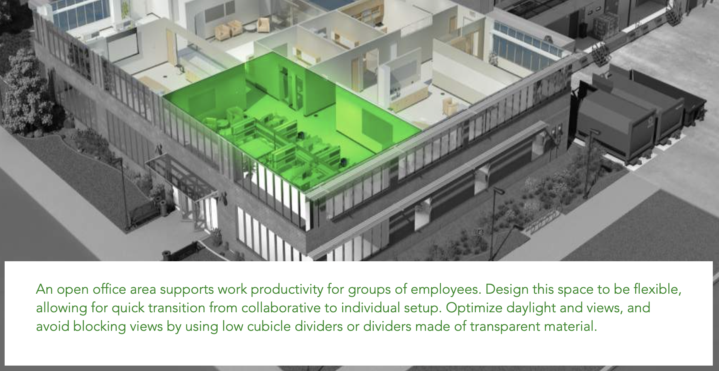
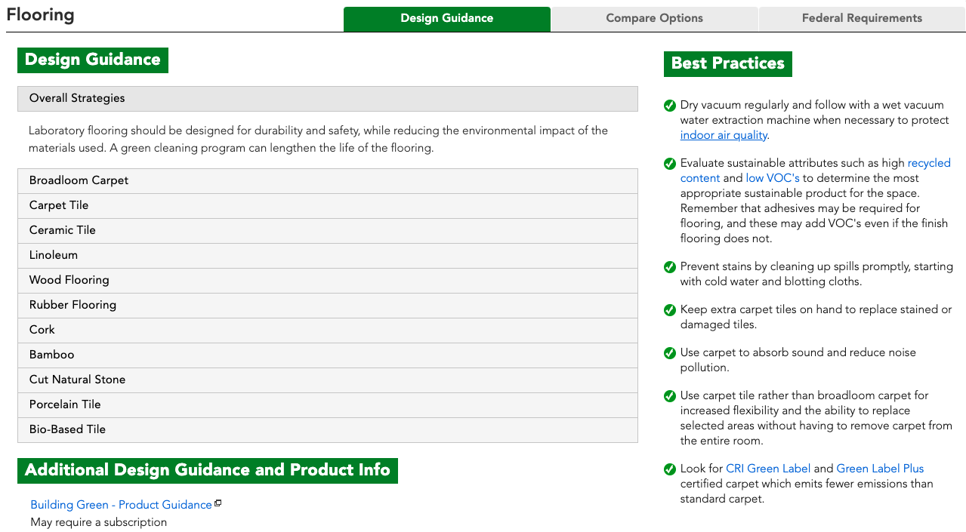
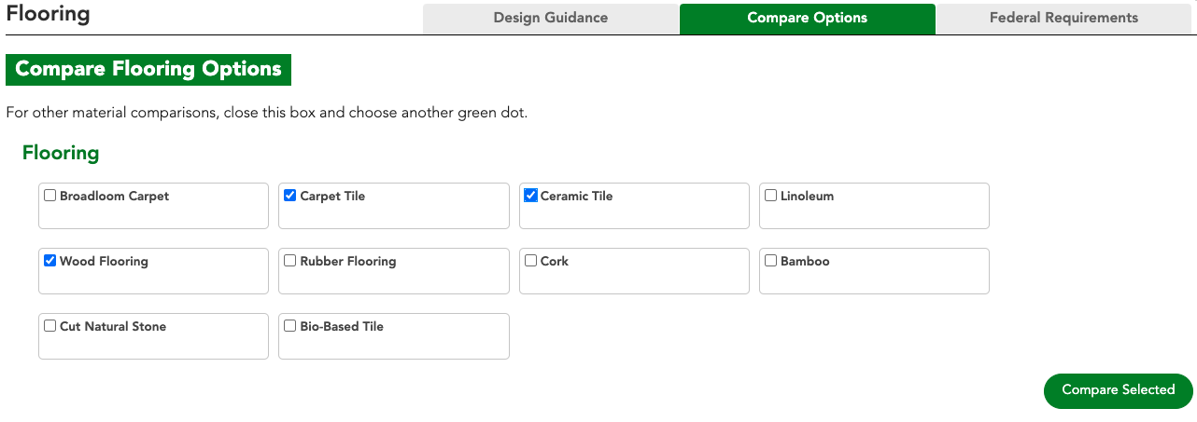
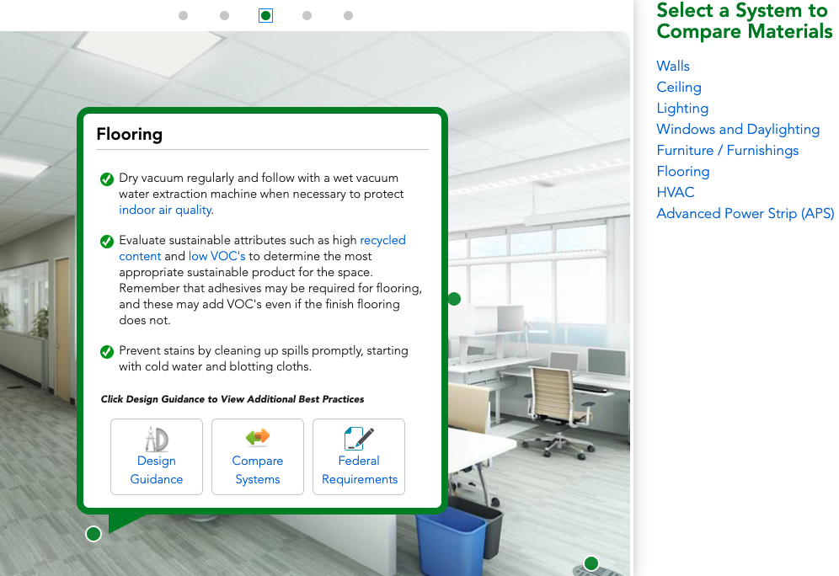
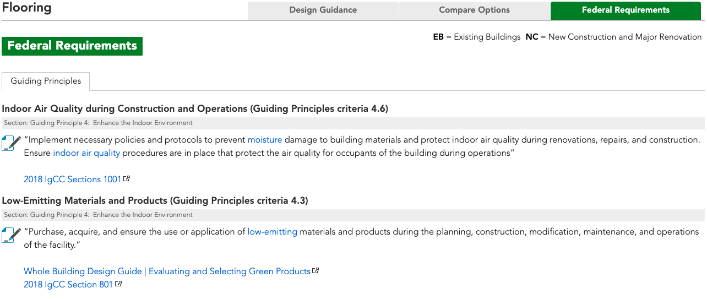
Workspaces
sftool.gov/explore#workspaces
Learn fundamentals and additional best practices
Explore design strategies, building materials, and federal requirements
Notes:
ANIMATED SLIDE IN TWO SEQUENCES – BY CLICK
STARTING ON THE SLIDE
Explore interior office Workspaces and learn about learn about sustainable design and best practices as you compare materials.
https://sftool.gov/explore#workspaces
SEQUENCE 1:
Upon selecting a building space, SFTool will take you inside the space. Click through Green Dots to learn more about the systems that make up a building space.
SEQUENCE 2:
More best practices for each system, including Design Guidance, Compare Materials, and Federal Requirements can be found in each Green Dot.

Slide 8
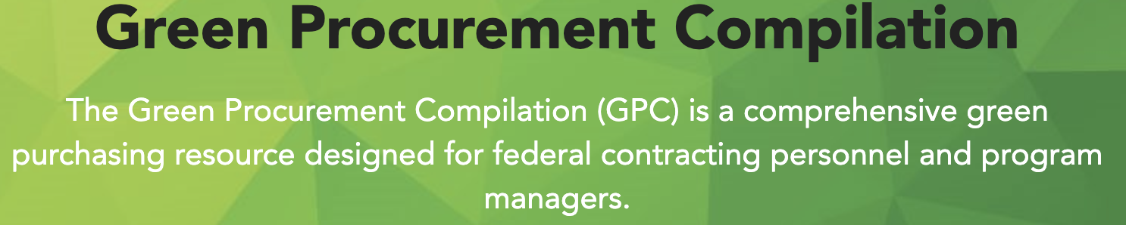
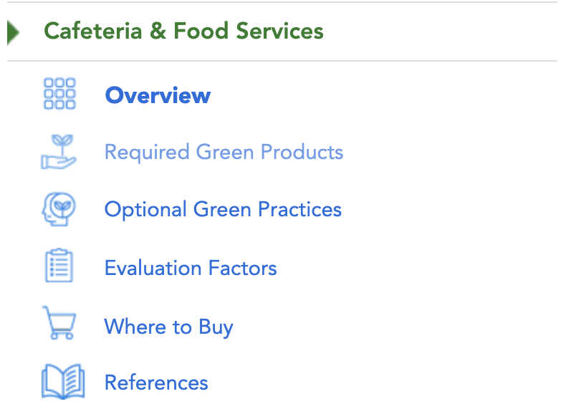
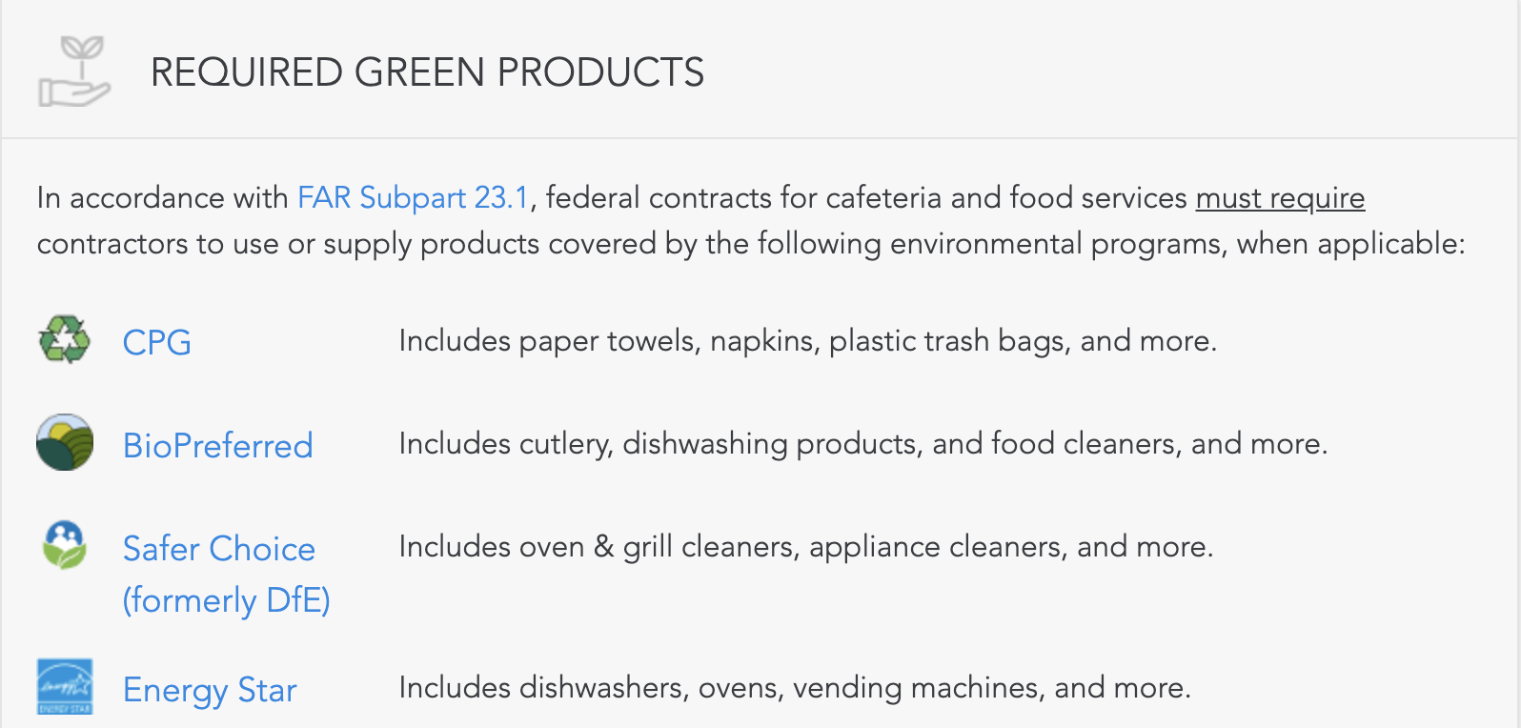
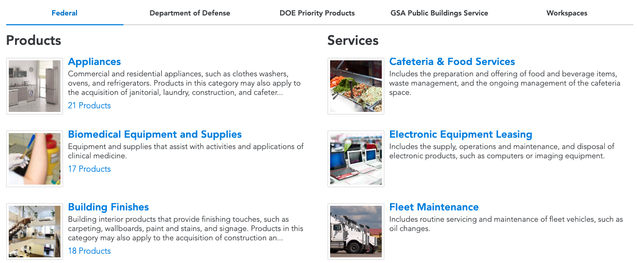
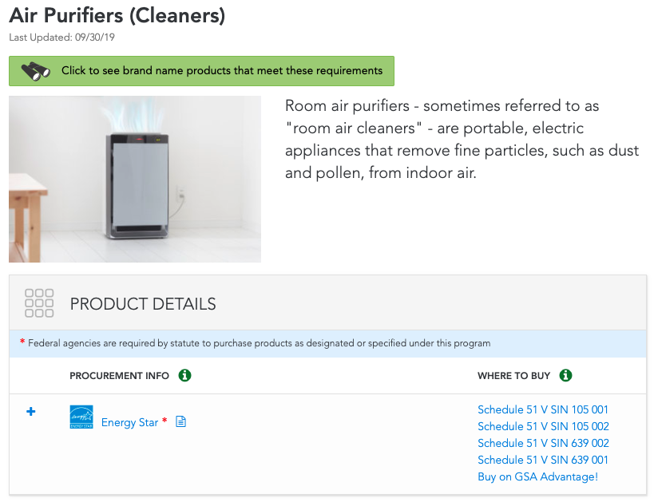
Green Procurement
sftool.gov/greenprocurement
Discover services to support sustainable workspaces
Find products that match specifications
Explore requirements, Guiding Principles, and additional resources for each product
sftool.ecomedes.com
Notes:
ANIMATED SLIDE IN FOUR SEQUENCES – BY CLICK
STARTING ON THE SLIDE
The Green Procurement Compilation (GPC) is a comprehensive green purchasing resource designed for federal contracting personnel and program managers.
https://sftool.gov/greenprocurement
SEQUENCE 1
Products are curated by category or workspaces, and additional guidance is provided for the Department of Defense, DOE Priority Products, and GSA Public Building Services.
SEQUENCE 2
Product Details: High-level description of the product, procurement information, and resources for purchasing.
Legal Requirements: Lists federal requirements related to the purchase of an item, including applicable Federal Acquisition Regulation (FAR) requirements.
Life Cycle Cost Savings: quantify the financial impact of a product over its entire life cycle to assist consumers in making decisions.
Guiding Principles: How the product can contribute to meeting the Guiding Principles for High Performance and Sustainable Buildings.
SEQUENCE 3
The SFTool Product Search streamlines sustainable product procurement. Search compliant products by energy and water performance through 150 categories, representing 5,700 brands and more than 300,000 products.
https://sftool.ecomedes.com/
SEQUENCE 4
Like Products, SFTool has a Services compilation for sustainable workspaces.
A collection of resources are provided for each of the service categories
SEQUENCE 5
Required Green Products in accordance with Federal Acquisition Regulation (FAR) 23.1 are listed and linked to;
Additional Optional Green Practices are provided;
Evaluation Factors to consider are explained;
And Where to Buy resources from the GSA Multiple Award Schedules are provided.

Slide 9

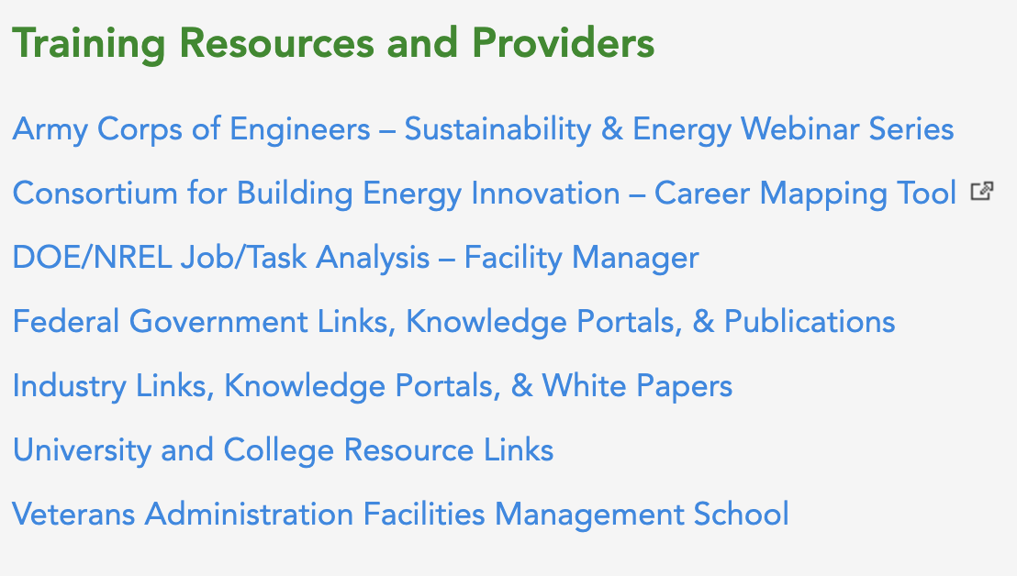
Train
sftool.gov/train
Access FEDSAT training and additional free learning resources
Notes:
ANIMATED SLIDE IN THREE SEQUENCES – BY CLICK
STARTING ON THE SLIDE
SFTool is home to Facilities Management Institute Training and Resources.
https://sftool.gov/train
FMI brings together government, industry and academia with the goal of integrating, aligning and innovating all aspects of the Facilities Operations and Management profession through continuous collaboration on core competencies, curriculum, and continuing education.
SEQUENCE 1:
Training and Resources and Providers for building manager professionals are provided from various federal and academic sources that can be applied to your career.
SEQUENCE 2:
The Federal Facilities Skills Assessment Tool (FEDSAT) is a no-cost, online skills assessment tool for Federal Buildings Personnel Training Act (FBPTA) effected personnel to demonstrate knowledge of recognized high priority FBPTA performances, defined as typical job functions for facilities personnel.
https://sftool.gov/fedsat
Through FEDSAT, users can assess their knowledge of the high priority performances, identify areas where additional training is needed, and locate free training resources available from the Federal government, industry associations, and other sources, to fill gaps in recognized high priority FBPTA performances.
Continuing Education Credit can be earned by completing FEDSAT. A list of free online courses that provide continuing education credits applicable to multiple standards is provided on SFTool in addition to the FEDSAT training.
Additional resources are available in the following competency areas: Facilities Operations and Maintenance, Facilities Management Technology, Energy Management, Water Efficiency, Sustainability, Performance Measures, and Leadership and Project Management.
SEQUENCE 3:
Upon successful demonstration of applicable high priority performances users will receive a FEDSAT Certificate of Completion. A FEDSAT Certificate of Completion is the first step on a path towards additional training that can lead towards full FBPTA compliance.

